Slide 1



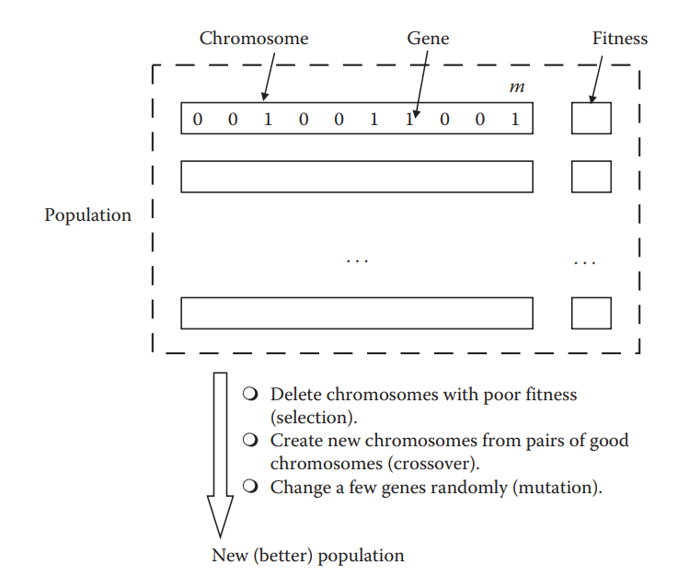







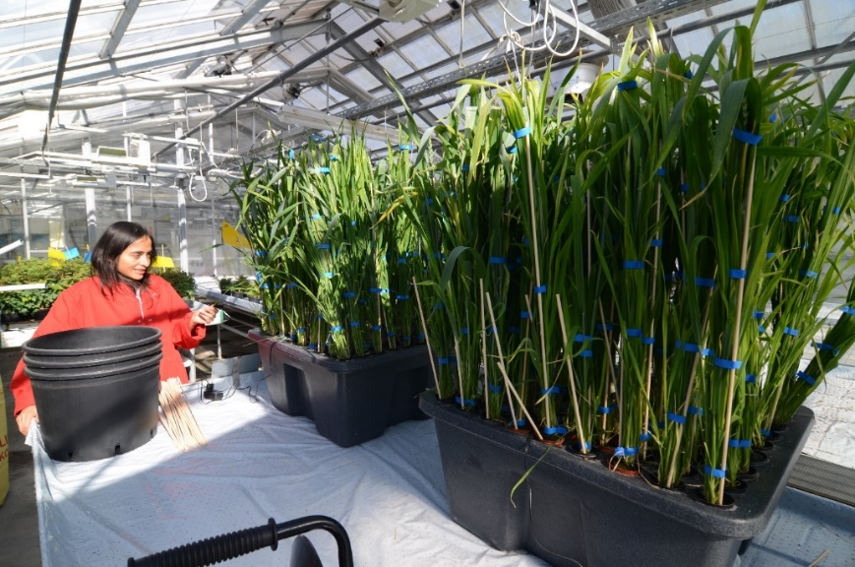
Determination of Silicon in Wheat Leaves with ATR-FTIR and -Chemometrics
Andrés Beltrán¹; Andrés Cabrera¹, Yohanna Cabrera²
¹ LICE, Departamento de Química, Facultad de Ciencias, Universidad Nacional de Colombia, Bogotá (Colombia)
² Department of Geosciences and Natural Resource Management Forest, Nature and Biomass, university of Copenhagen (Dinamarca)
Abstract
Using varying sets of wave numbers selected by a genetic algorithm, a series of models based on multivariate ordinary least squares regression was built using baseline baseline-corrected ATR-FTIR spectra from wheat leaves samples. Models built with these sets showed a powerful strong correlation with the silicon content determined by elemental analysis. The performance in prediction of each model was assessed using repeated k-fold cross cross-validation, showing a maximum error of prediction (RMSEP) of 0.1% wt. with minimum model complexity of 4 selected variables. However, a strong dependence on the matrix was noted when compared with other plant tissues.
Introduction
The beneficial effects of silicon for plants have been noticed for more than a century, but only during the last two decades has its role in high productivity agriculture systems been thoroughly studied. The presence of silicon in plants contributes stress-relief mechanisms for environmental events such as drought and pathogen attack. Because of the importance of crops such as wheat, barley, rice, and other grasses that accumulate Si, understanding the relationship between this element and plant science is the focus of numerous scientific efforts. Si quantification is a difficult and costly task, and destructive wet chemistry methods are commonly used. With the recent development of chemometric tools, analysis of silicon in complex matrices have has been proved feasible.
Methods
Se cultivaron, mediante cultivo hidropónico, tres grupos de plantas de trigo. Éstos grupos se diferenciaron por el suministro de silicio en forma de Na₂SiO₃. Las plantas del primer grupo, definido como (Si +), crecieron durante 90 días en presencia de Na₂SiO₃ 1.5 mM. Las plantas del grupo definido como (Si ++) crecieron sin suministro de silicio hasta el día 85, en el que una solución 1.5 mM de Na₂SiO₃ fue añadida al tanque que las contenía. A su vez, se cultivó un tercer grupo de plantas control a las que no se les suministró silicio (Si-) durante todo el proceso.
Results
Aquí Un dibujo ‘diagrama bonito de entrenamiento del algoritmo en vez de la flecha a la derecha
Si
Figura #: Procedimiento de pre procesamiento de datos.
Figura #: Error de predicción para validación cruzada repetida en función de la complejidad del modelo.
Conclusion
References
[1] Chen, H., Ferrari, C., Angiuli, M., Yao, J., Raspi, C., & Bramanti, E. (2010). Qualitative and quantitative analysis of wood samples by Fourier transform infrared spectroscopy and multivariate analysis. Carbohydrate polymers, 82(3), 772-778.
[2] Varmuza, K., & Filzmoser, P. Introduction to multivariate statistical analysis in chemometrics. CRC press, 2016.
Imagen 1: Proceso de cultivo de las muestras analizadas.

